Slide 1
RAMADDA
Repository for Archiving and MAnaging Diverse Data
Content management system
Scientific data repository
Wiki
Visualization environment
Technology
Open source
Java based
Runs stand-alone or in a servlet container

Slide 2
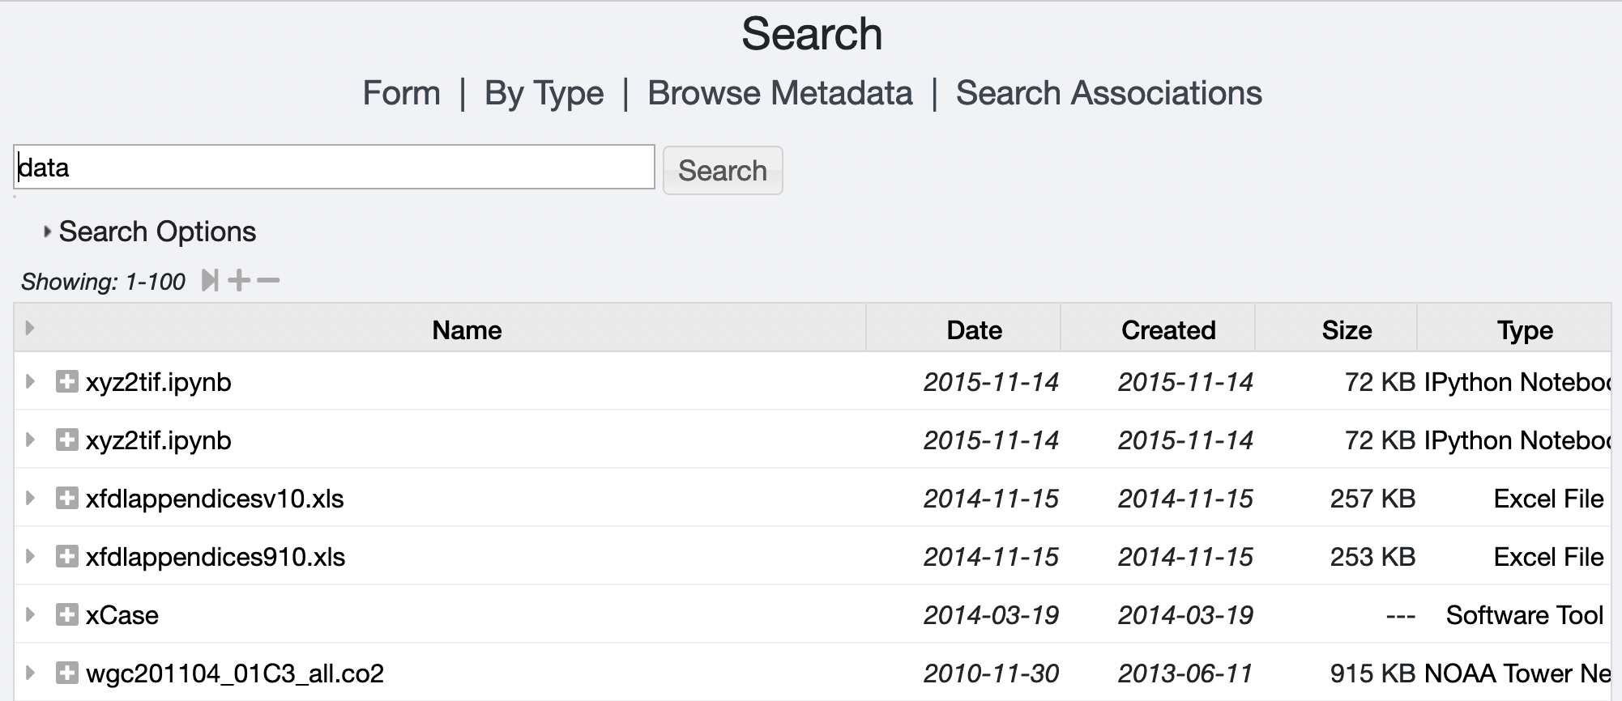
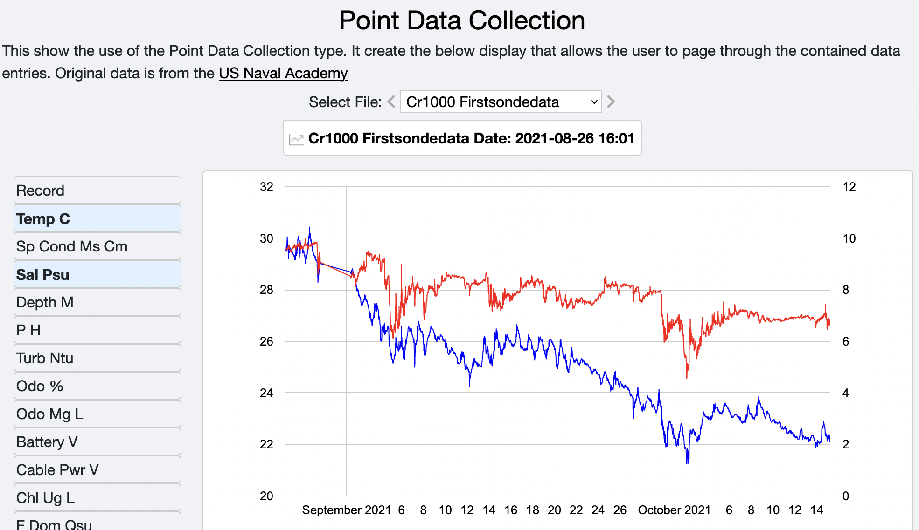
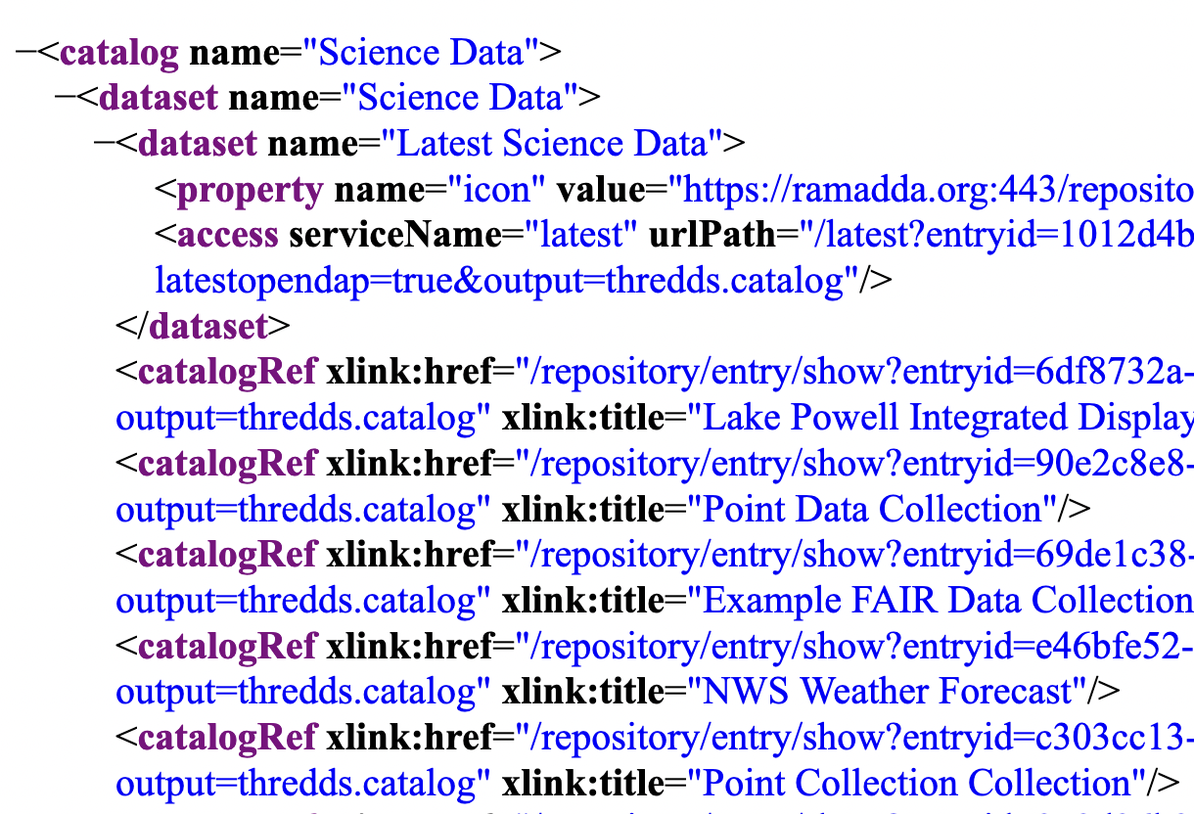
RAMADDA Model
Hierarchy of typed entries
Search
Folder
Tag
Folder 1
Folder 2
Wiki text
Keyword
Displays
Alias
Wiki page
Image
Thumbnail
Services
RSS
Catalogs
Data
…
Properties attached to entries

Slide 3
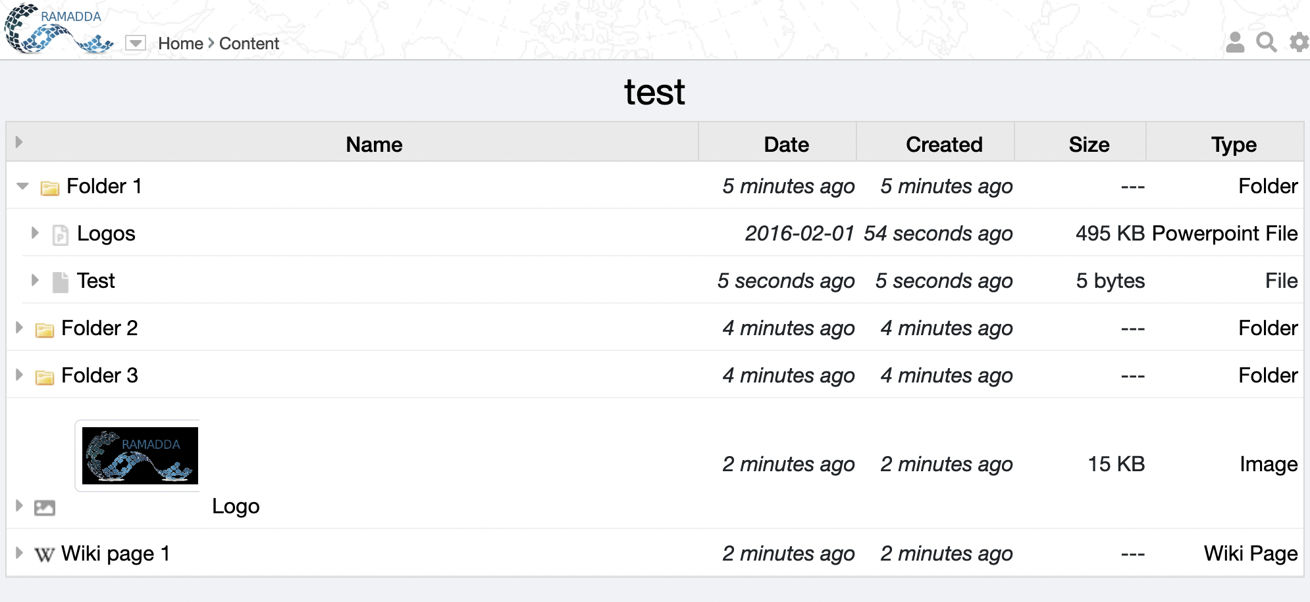
Entry Display
You are always viewing an entry.
Here it is a folder called “test”
Login, search, settings, help
Breadcrumbs
Click on a link to go to that entry
Click on an arrow to open in place
There are folders, files
and other types of entries

Slide 4
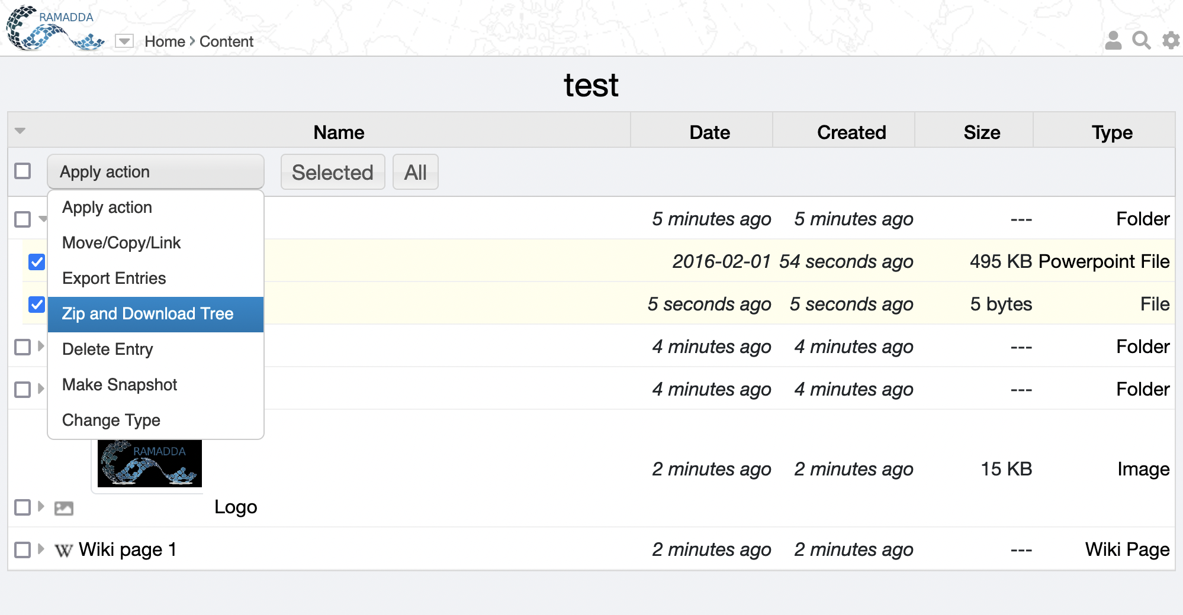
Managing multiple entries
Toggle form
Select action
Do it
Select entries

Slide 5
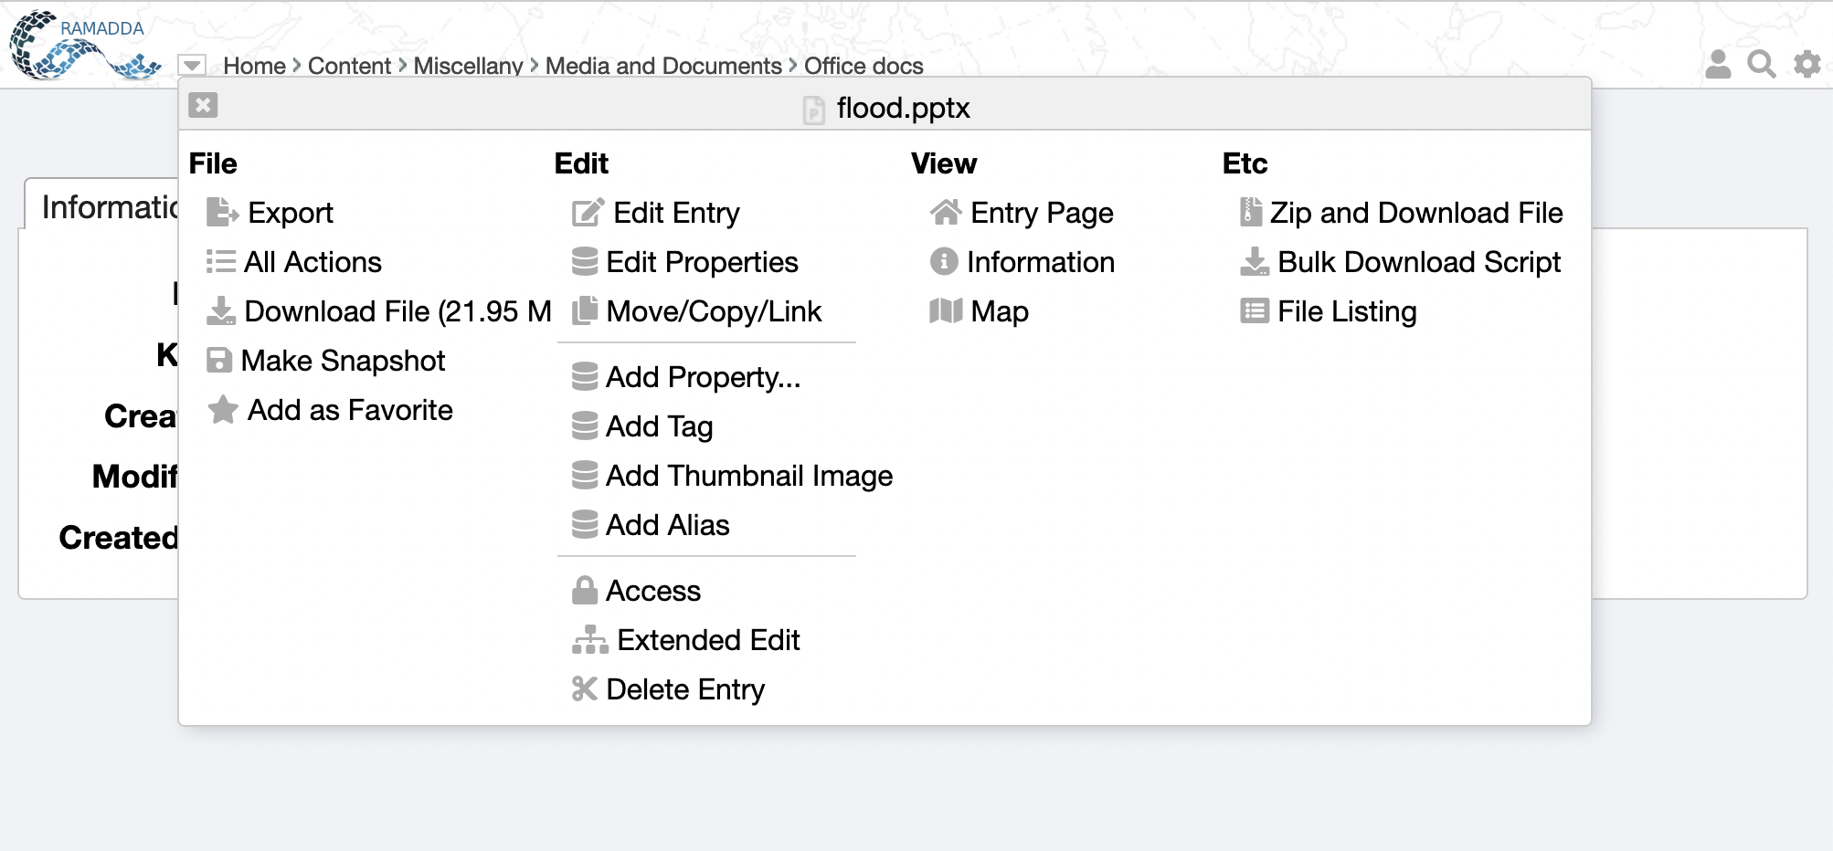
Entry Popup Menu
Popup menu
Information
All actions

Slide 6
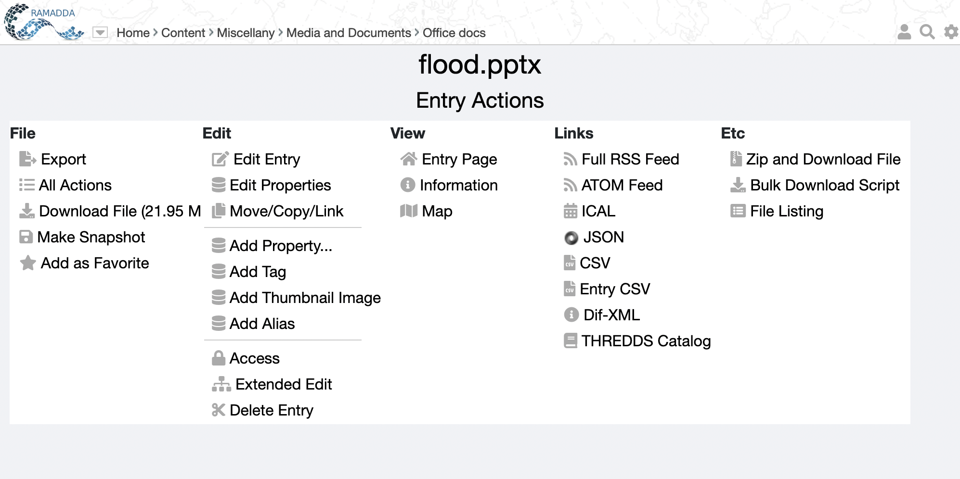
All Actions
All Action

Slide 8
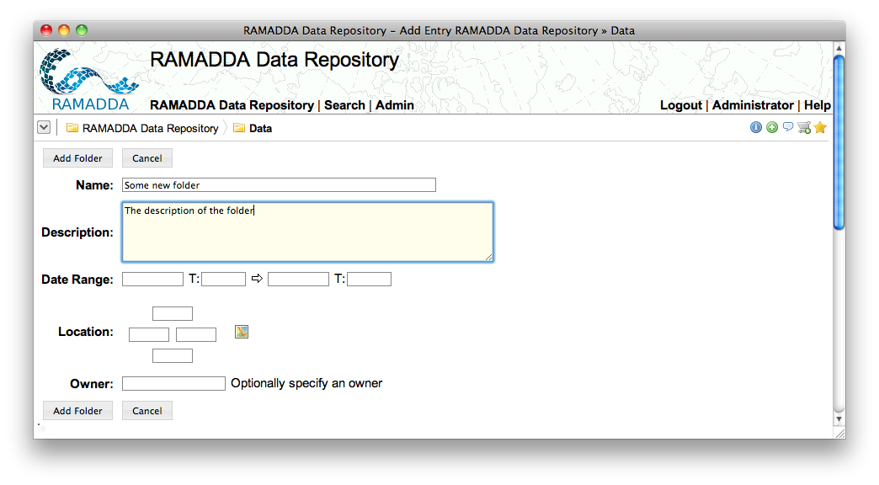

Slide 9
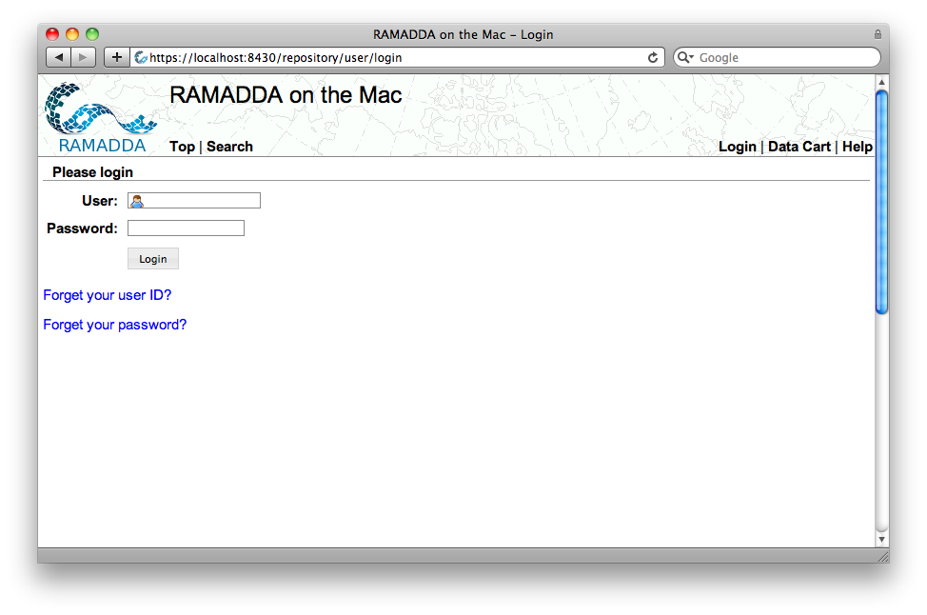
Login link
If the repository has been configured to send email these links will be shown

Slide 10
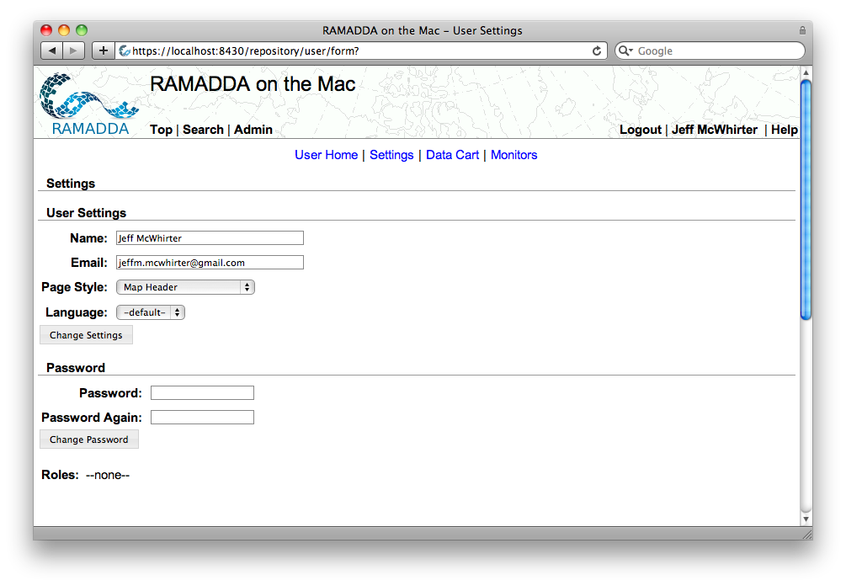
When you are logged in you should see a Logout. You user name takes you to the User Settings page
The User Home link shows all of your “Favorite” entries
Change preferred page style, language, etc

